Slide 1
Using SCSS(Syntactically Awesome Stylesheet)

Slide 2
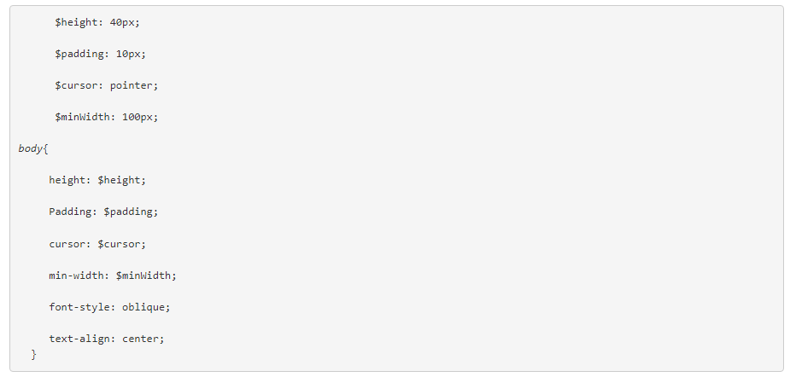
Using SCSS(Syntactically Awesome Stylesheet)

Slide 3


Slide 4



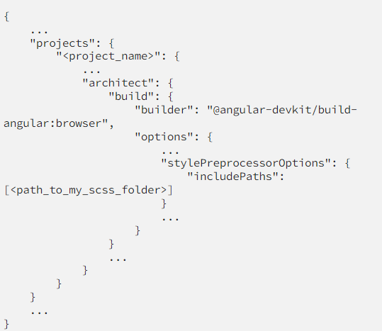

Slide 5
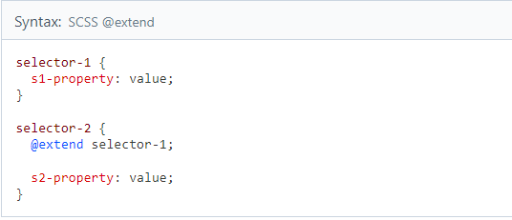
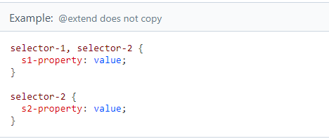
Inheriting properties with @extend

Slide 6
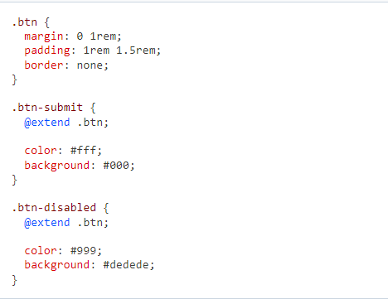
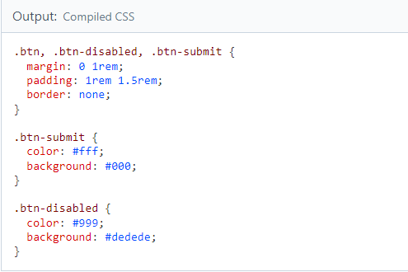
Button Example

Slide 7

Demo
Angular 16 Scss Project
Using Variables in Scss
Scss imports
How to Write a Mixin
Inheriting properties with @extend

